Slide 1
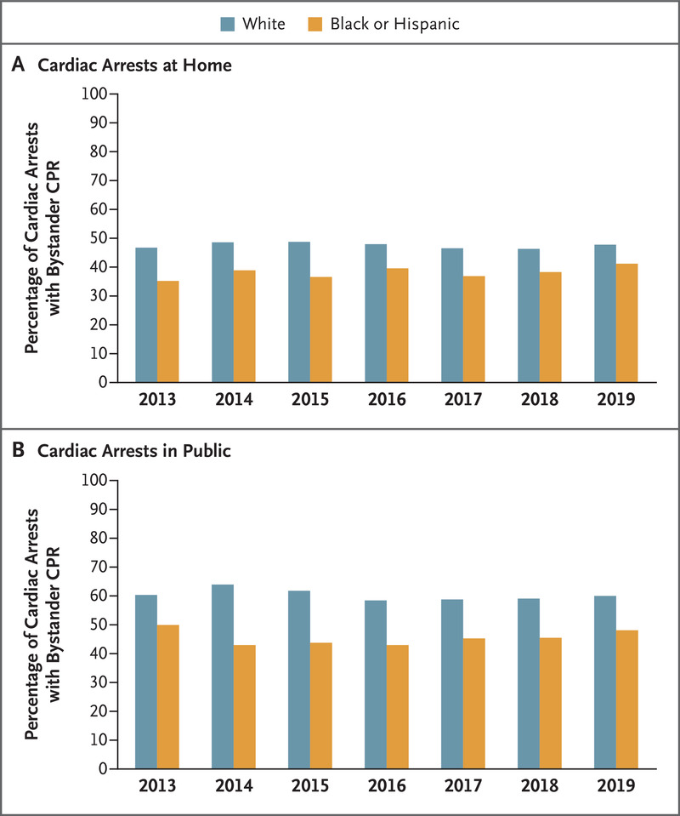
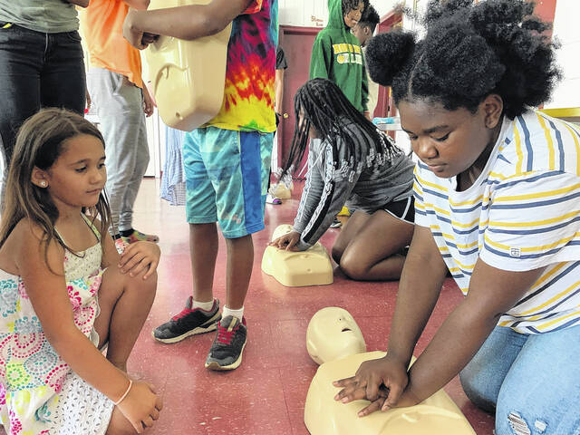
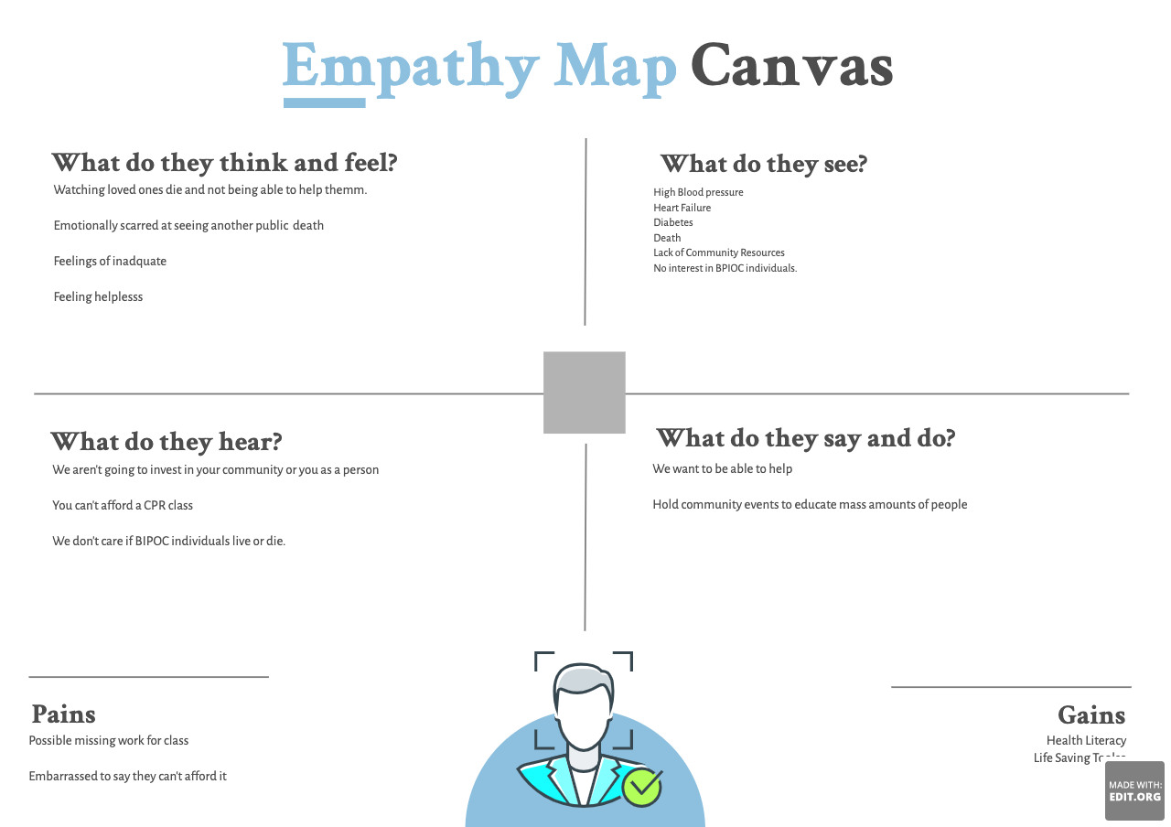
Quality and Safety in Health Care: Increasing CPR Bystander Rates within Black and Hispanic Communities
Black and Hispanic Cardiac Deaths
Whole Health Quality
The Nurse Executive’s Plan
CPR Disparity
Community Partnership/Planning
High Cardiac Arrest Occurrence
(Medline Plus, 2016)
(Dreamstime, 2018)
(Lincoln Health, 2022)
(Duke Health, 2022)
Low Bystander CPR Rates
Community Course on CPR
Empathy Map Planning
(Garcia et al., 2022)
(AHA, 2021)
(Sinclair, 2022)
Higher Death Rates
Increased CPR Bystander Rates
(AHCA, 2022)
Tumani Jackson, BSN, RN University of Minnesota School of Nursing. NURS 6705 Quality and Safety in Health Care
Education on CPR
Notes:
As a nurse and a person of color, there is no doubt in my mind that racism and discrimination still exist deeply within all facets of America. “The inequalities facing African Americans go deeper than just interactions with police: from lower wages to longer commute times, the structure of the world's largest economy deeply marginalizes black people” (Stein, 2020). One can safely assume that these disparities have a direct effect on health care as well. Health care and the lack of access to educational opportunities is another issue that Black/African American’s face (Hostetter & Stein, 2018). “Compared with whites, members of racial and ethnic minorities are less likely to receive preventive health services and often receive lower-quality care. They also have worse health outcomes for certain conditions” (Hostetter & Stein, 2018). The New England Journal of Medicine conducted a study and pulled out-of-hospital cardiac arrest data from 2013 – 2019 (Garcia et. al, 2022). According to the New England Journal of Medicine (2022) out of 110, 054 cardiac arrests, 35,469 of those were Black or Hispanic individuals. The study found, “Black and Hispanic persons were less likely to receive bystander CPR at home (38.5%) than White persons (47.4%) (adjusted odds ratio, 0.74; 95% confidence interval [CI], 0.72 to 0.76) and less likely to receive bystander CPR in public locations than White persons (45.6% vs. 60.0%) (adjusted odds ratio, 0.63; 95% CI, 0.60 to 0.66).”
According to Garcia et al. (2022) “CPR training is less commonly conducted in Black and Hispanic communities, and dispatcher – assisted bystander CPR may not be as readily available. These differences between neighborhoods may be the consequence of structural racism that has led to unequal investments in CPR training and community infrastructure.” To further understand and dissect this issue, one could use an empathy map to understand the community and the possible barriers that community members face in a medical emergency such as cardiac arrest.
As a nurse executive, increasing CPR education/certification within the community is the goal. In efforts to tackle this issue, we must first identify the community location. We then need to identify if there are any CPR classes near the community. We need to examine location, availability, income, and costs. We must then find a community partner if one has not been established who can offer low cost or free CPR education. The area that I would implement these changes, has a major hospital system that can teach CPR to the community. Once these components have been identified, we begin implementing classes for community members to attend and participate. These classes should be held within the community at a central location (Lincoln Community Center) and at a low cost or free of cost fee.
The community in which this program would take place is near one of the top heart centers (MI, valve replacement, and transplant) in the U.S. This organization (Duke University Hospital) serves most community members in the event of an MI or full cardiac arrest. Involving the organization could not only reduce the amount of cardiac arrest seen in the community but also seen within the hospital’s system. Having CPR courses that target Black and Hispanic individuals keeps the hospital involved at the community level and allows for the community to not only be involved with learning from the hospital but also learning for themselves and their community. This is a partnership that could maintain a healthy and positive relationship between community members and the hospital that serves them.
Nurse Executives (NE) should, “Introduce rudimentary quality planning to put customer needs immediately at the forefront” (Sampath et al., 2021 pg 40) The data shows a clear disparity amongst Black and Hispanic bystanders when cardiac arrest has taken place. The evidence shows that this could be linked to a lack of CPR education. By placing the needs of the community members first, which is a lack of education and training in CPR, we can successfully address this portion of the issue. The NE should also, “Develop a learning system to ensure strong linkages between all QP, QI, and QC activities” (Sampath et al., 2021 pg 38). The learning system of CPR that has been created, needs to be tracked to ensure that community members feel that they have received adequate knowledge to be able to use in the real world. This can be done through surveys and other quality metrics. Lastly, the NE should, “Refine the role of quality department staff and rightsize the QI function to optimally support the QP and QC workstream” (Sampath et al., 2021 pg 38). Once a program has been implemented, we must examine the relationship between the quality team and service assurance within the CPR program. The final recommendation of the NE would be, “to review the roles and responsibilities of quality staff to identify the right balance between quality assurance activities and support for the quality management system itself (e.g., supporting executives in quality planning, supporting teams in QC and QI), and to ensure a consistent improvement approach is used throughout the organization.” This ensures that the program serves the community and their needs, which will give us our end results of increased bystander CPR rates.
Reference:
Garcia RA;Spertus JA;Girotra S;Nallamothu BK;Kennedy KF;McNally BF;Breathett K;Del Rios M;Sasson C;Chan PS;, R. A. G. J. A. S. (n.d.). Racial and ethnic differences in bystander CPR for witnessed cardiac arrest. The New England journal of medicine. Retrieved November 16, 2022, from https://pubmed.ncbi.nlm.nih.gov/36300973/
In focus: Reducing racial disparities in health care by confronting racism. Commonwealth Fund. (2018, September 27). Retrieved November 16, 2022, from https://www.commonwealthfund.org/publications/2018/sep/focus-reducing-racial-disparities-health-care-confronting-racism
Stein, C. (2020, June 5). Black Americans suffer from generations of economic marginalization.
Barron's. Retrieved November 16, 2022, from https://www.barrons.com/news/black-americans-suffer-from-generations-of-economic-marginalization-01591321825
Whole system quality: IHI. Institute for Healthcare Improvement. (n.d.). Retrieved November 16, 2022, from https://www.ihi.org/resources/Pages/IHIWhitePapers/whole-system-quality.aspx

